Slide 1
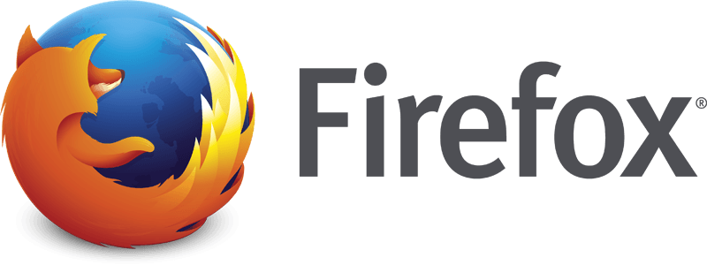
MOZILLA FIREFOX

Slide 2
WHAT IS FIREFOX?
CREATED BY MOZILLA, THE ORIGINAL CREATORS OF THE NETSCAPE SERIES OF BROWSERS.
IT IS A FREE, OPEN SOURCE WEB BROWSER & NON PROFIT ORGANIZATION.
IT IS HIGHLY CUSTOMIZABLE.
SIMILAR TO INTERNET EXPLORER, BUT YES MUCH DIFFERENT!

Slide 3
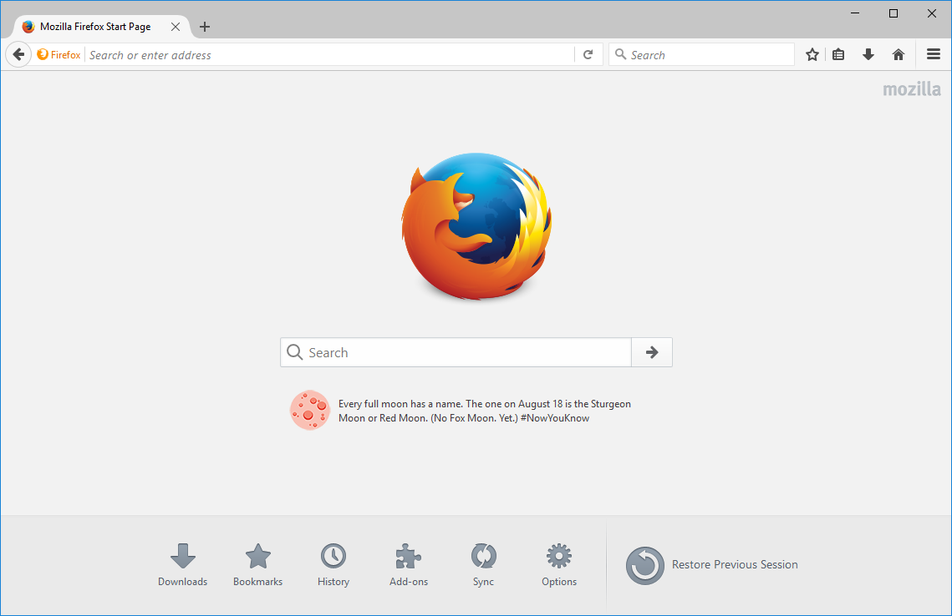

Slide 4
HISTORY OF FIREFOX
FIREFOX WAS CREATED IN 2002 UNDER THE NAME “PHOENIX” BY MOZILLA COMMUNITY MEMBERS WHO DESIRED A STANDALONE BROWSER.
IT WAS ORIGINALLY TITLED “PHOENIX”, WHICH HAD ROSE FROM THE ‘ASHES’ OF NETSCAPE NAVIGATOR AFTER IT HAD BEEN KILLED OFF BY MICROSOFT INTERNET EXPLORER.
LATER, PHOENIX WAS RENAMED DUE TO TRADEMARK ISSUES AND THE REPLACEMENT NAME “FIREBIRD” PROVOKED AN INTENSE RESPONSE FROM THE FIREBIRD DATABASE SOFTWARE PROJECT
THEN,ON FEBRUARY 9,2004 DUE TO FURTHER PRESSURE PUT ON BUT THE FIREBIRD DATABASE SOFTWARE PROJECT,”MOZILLA FIREBIRD” BECAME “MOZILLA FIREFOX”.

Slide 5
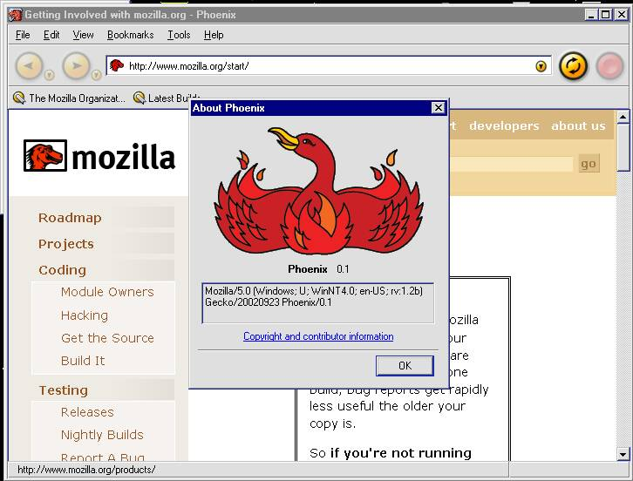

Slide 6
LICENSING OF FIREFOX
FIREFOX SOURCE CODE IS FREE SOFTWARE, WITH MOST OF IT BEING RELEASED UNDER THE MOZILLA PUBLIC LICENSE(MPL).
THIS LICENSE PERMITS ANYONE TO VIEW, MODIFY, OR REDISTRIBUTE THE SOURCE CODE.
CODE LICENSED UNDER MPL1.1 COULD NOT BE LEGALLY LINKED WITH CODE UNDER GPL, HENCE TO ADDRESS THESE CONCERNS, MOZILLA RE-LICENSED MOST OF FIREFOX UNDER THE TRI-LICENSE SCHEME OF MPL 1.1, GPL 2.0, OR LGPL 2.1
LATER MOZILLA RELEASED THE GPL-COMPATIBLE MPL 2.0 AND USED IT TO REPLACE THE TRI-LICENSING SCHEME.

Slide 7
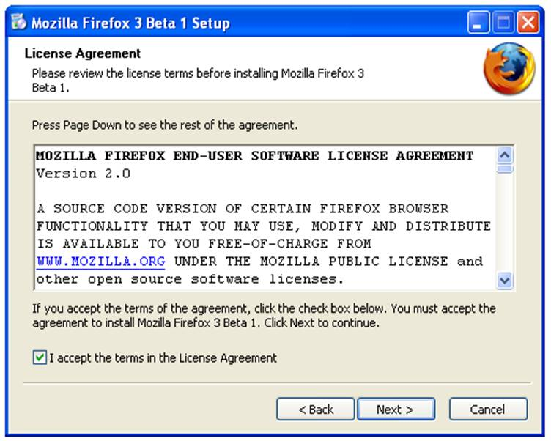

Slide 8
TRADEMARK AND LOGO
THE NAME “MOZILLA FIREFOX” IS A REGISTERED TRADEMARK ; ALONG WITH THE OFFICIAL FIREFOX LOGO, AND IT MAY ONLY BE USED UNDER CERTAIN TERMS AND CONDITIONS
ANYONE MAY REDISTRIBUTE THE OFFICIAL BINARIES IN UNMODIFIED FORM AND USE THE FIREFOX NAME AND BRANDING FOR SUCH DISTRIBUTION.
BUT RESTRICTIONS ARE PLACED ON DISTRIBUTIONS WHICH MODIFY THE UNDERLYING SOURCE CODE.
MOZILLA HAS PLACED THE FIREFOX LOGO FILES UNDER OPEN-SOURCE LICENSES, BUT ITS TRADEMARK GUIDELINES DO NOT ALLOW DISPLAYING ALTERED OR SIMILAR LOGOS IN CONTEXT WHERE THE TRADEMARK LAW APPLIES.

Slide 9
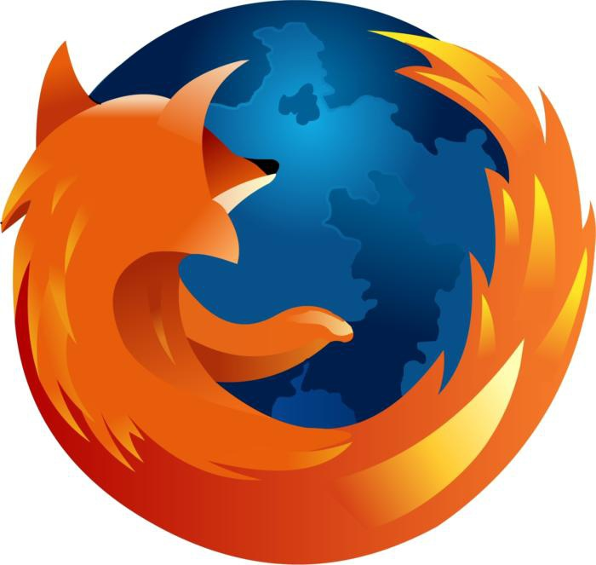
LOGO

Slide 10
PROMOTION AND MARKET ADOPTION
FIREFOX WAS ADOPTED RAPIDLY, WITH 100 MILLION DOWNLOADS IN ITS FIRST YEAR OF AVAILABILITY.
FIREFOX CONTINUED TO HEAVY MARKET ITSELF BY RELEASING A MARKETING PORTAL DUBBED”SPREAD FIREFOX”IN 2004.
DOWNLOADS HAVE CONTINUED AT AN INCREASING RATE SINCE FIREFOX 1.0 WAS RELEASED IN NOV2004, AND AS OF JULY2009.
FIREFOX HAS MORE THAN 450 MILLION USERS AS OF OCTOBER 2012.
FIREFOX WAS THE SECOND-MOST USED WEB BROWSER UNTIL DEC2011,WHEN GOOGLE CHROME SURPASSED IT.
AS OF FEB2016, FIREFOX WAS THE SECOND MOST WIDELY USED “DESKTOP BROWSER”.

Slide 11
Thank you..

